Slide 1
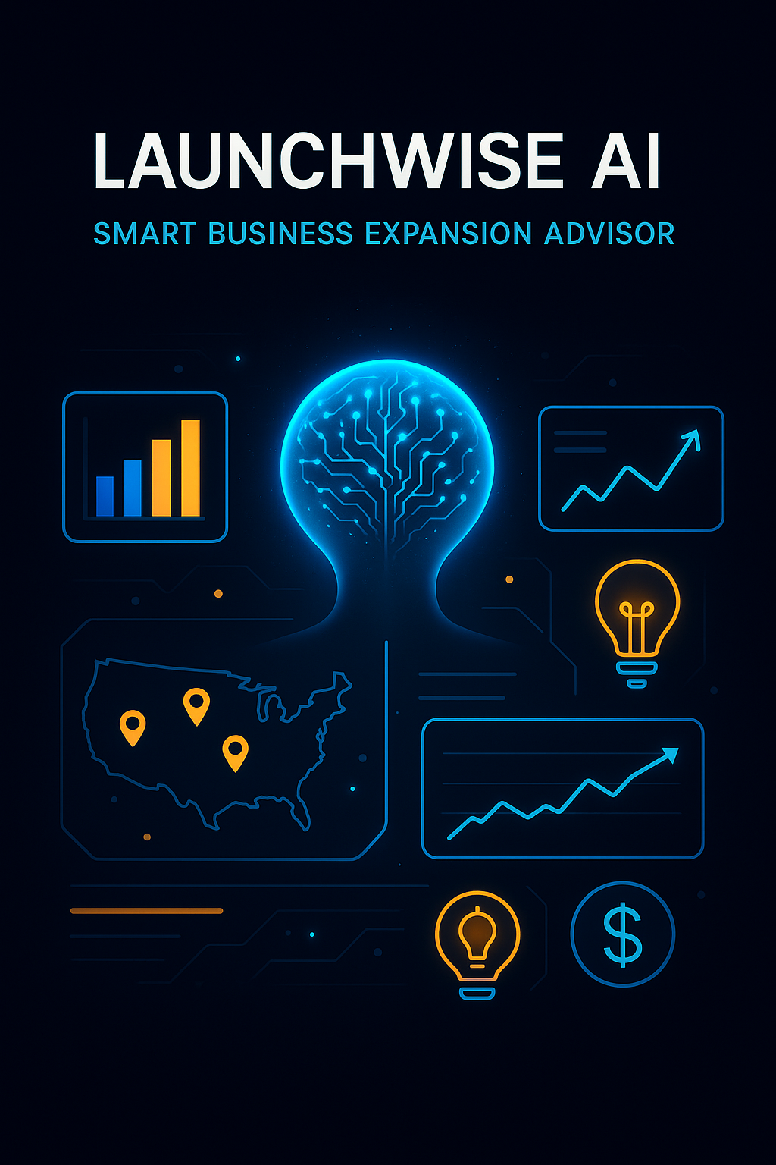
LaunchWise AI
Imagine you're an entrepreneur evaluating whether a new location — say, a densely populated county in New Jersey — is the right spot to open your next coffee shop or cleaning service. And you’re asking yourself one essential question:
"Will my business succeed here?"
That’s exactly where LaunchWise AI comes in.
LaunchWise AI combines Gemini’s generative power, real-world data, and vector search to emulate the thought process of a seasoned business analyst — instantly.
Whether you're eyeing a cleaning service in New Jersey or a café in Illinois, LaunchWise AI provides a structured, evidence-based recommendation grounded in demographics, competition, economic trends, and local regulations. And the best part? It all happens through a simple chat interface.
Now the question is no longer "what if?" — but "how exactly?".

Slide 2
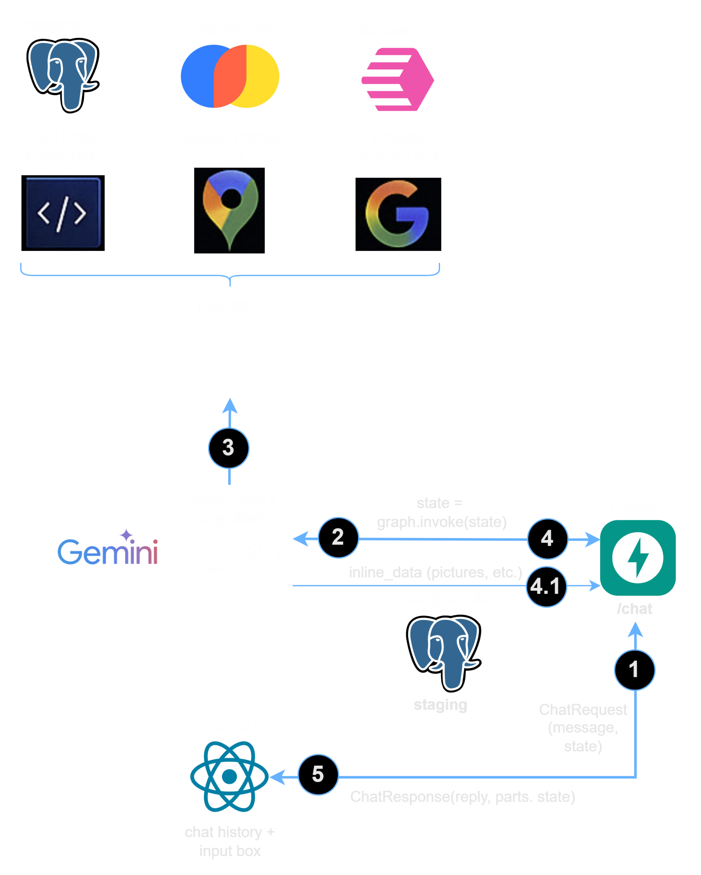
High-level architecture
Main components
React – front-end web application
FastAPI – back-end API server
LangGraph/LangChain – core GenAI component that communicates with Gemini-2.0-flash LLM
FastMCP – MCP server that exposes tools for LangChain
Postgres DB – database for staging data
Application flow
React application calls /chat API endpoint and passing state (the user prompt and conversation history)
API invokes LangGraph/LangChain passing state
LangGraph/LangChain may call tools through FastMCP
LangGraph/LangChain generates text response, adds it to state and returns to API as a graph response
Additional data generated by tools (e.g. pictures) is passed through Postgres DB as inline_data object
API method combines the text and inline_data responses together and returns to React application as an API response. The application renders the response

Slide 3
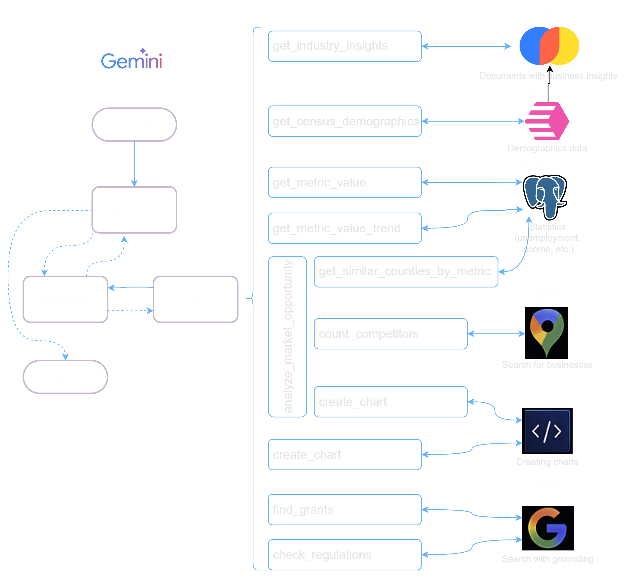
Available tools
get_industry_insights – RAG tools that extracts and summarizes insights from documents stored in ChromaDB
get_census_demographics – calls Census API to get metrics for county
get_metric_value – returns latest statistics for county pre-stored in PostgresDB
get_metric_value_trend – returns trend
analyze_market_opportunity – tool-in-a-tool framework (see next slide for details)
get_similar_counties_by_metric – searches up 10 similar counties by per capita income
count_competitors – calls Google Places API to count business in the county
create_chart – calls LLM’s Code Execution tool to generate a chart by its description and source data
find_grants – calls Search with grounding tool to get info about available grants
check_regulations – known regulations

Slide 4
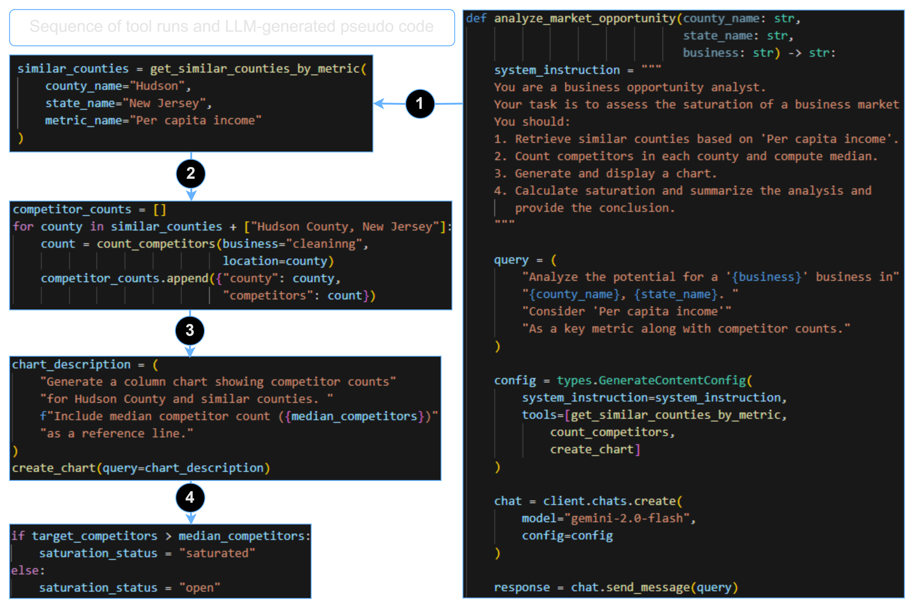
Tool-in-a-Tool framework
Analyze_market_opportunity tool does not analyze the market directly; instead, it passes a step-by-step system_instruction to the LLM, telling it which supporting tools to call (such as get_similar_counties_by_metric, count_competitors, create_chart) and how to synthesize the results into a cohesive strategy.
This approach turns a single user query into a full-fledged decision-making session, where the model acts like a business analyst — asking itself intermediate questions, calculating medians, comparing markets, generating charts — all within one call.

Slide 5
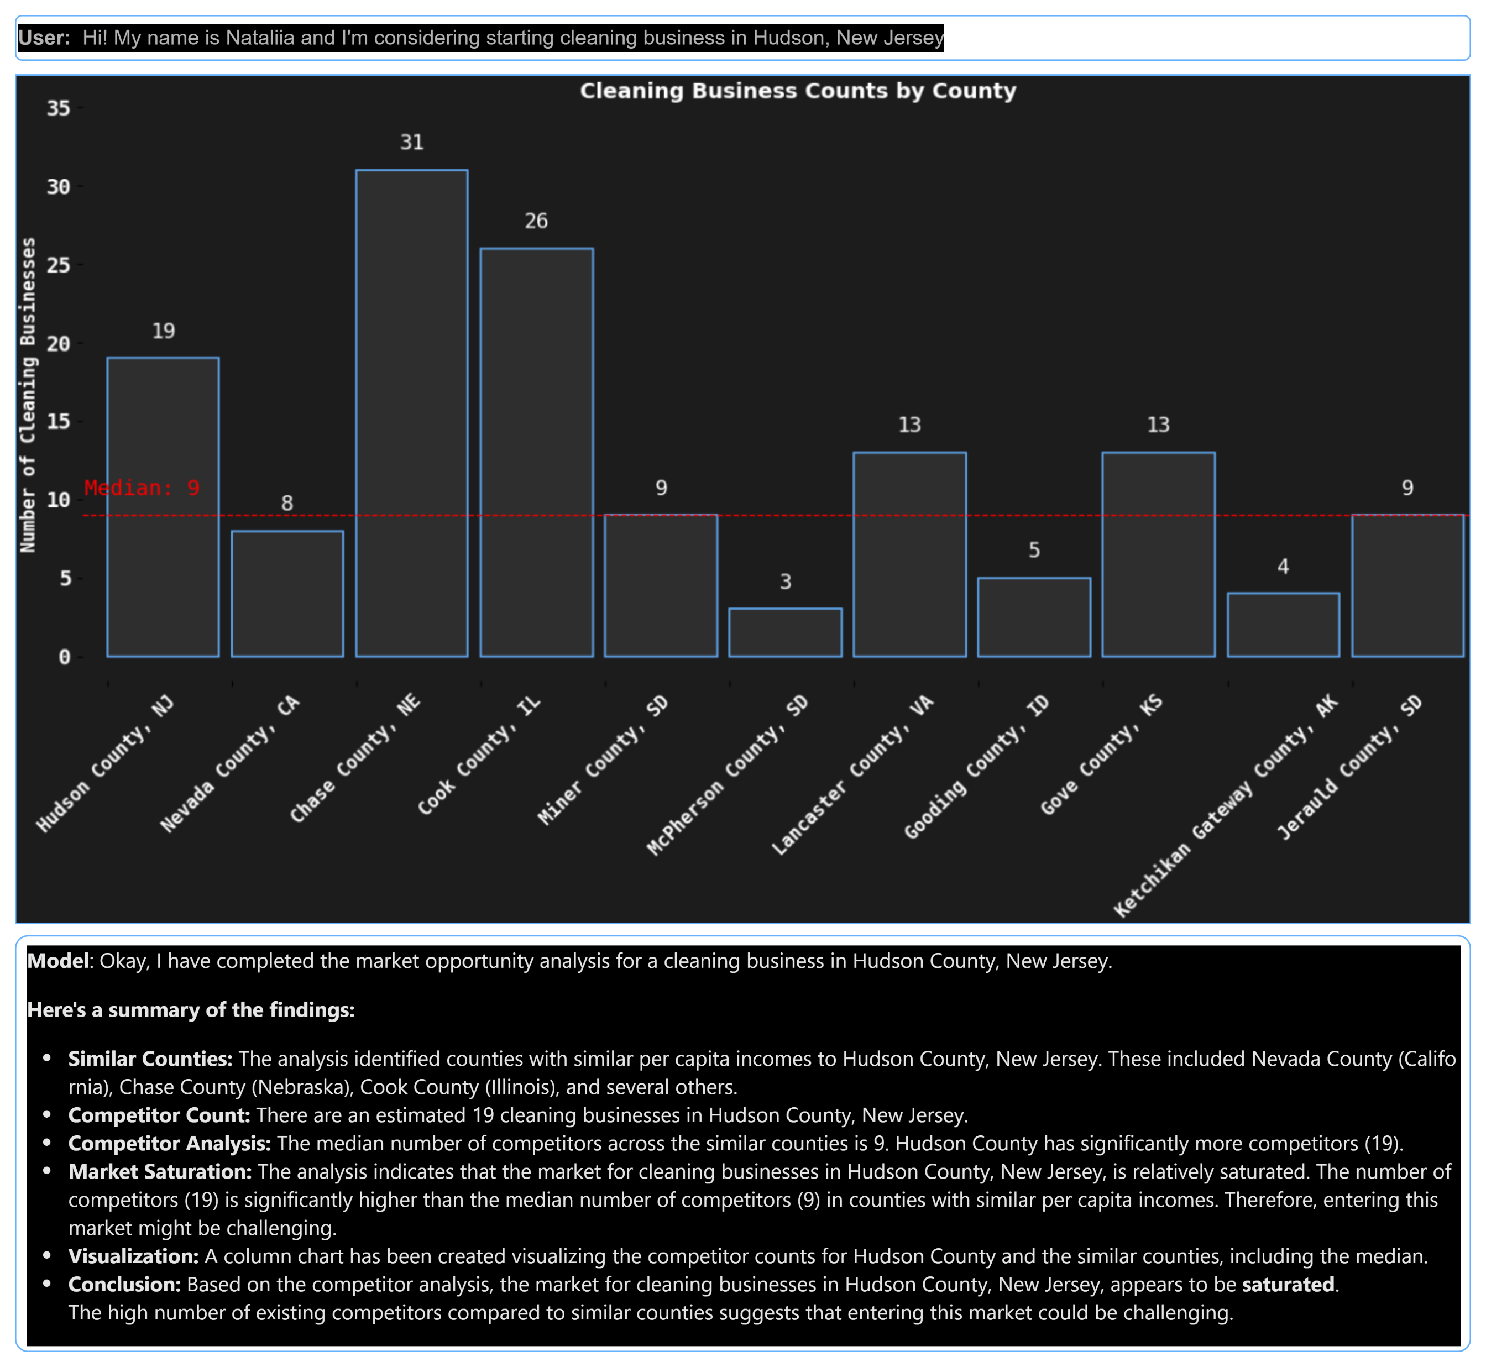
Sample conversation
Based on the system instruction LangGraph chat-bot first asks you about your name, business type and county and state where you are going to open your business
Then the chat asks, would you like to conduct a full market analysis. The result of such analysis in presented here
The user also can ask about other available tools and then leverage them by asking questions like:
“Show me a per capita income trend in the county as a line chart”
“Show me available grants options for my business in the county”
“Show me available industry insights for my business”
“Show me available Census metrics” – “Visualize male/female distribution as a pie chart”

